Slide 1
Cloud Security
Eng Gathams Ngosa

Slide 2
What are the major concerns, issues or fears
Man to woman relationship?
A person choosing between a bank and pillow to keep money.
renting or hiring as opposed to owning and buying PROPERTY
.

Slide 3
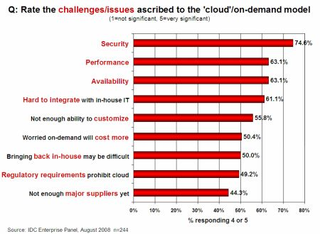
Security Is the Major Challenge

Slide 4
Global Cloud Security Market by End-User Segmentation

Slide 5
Dangers and Vulnerabilities
Security is to save data and program from danger and vulnerability
Dangers
Disrupts Services.
Theft of Information.
Loss of Privacy.
Damage information.
Vulnerabilities
Hostile Program.
Hostile people giving instructions to good programs.
Bad guys corrupting or eavesdropping on communications

Slide 6
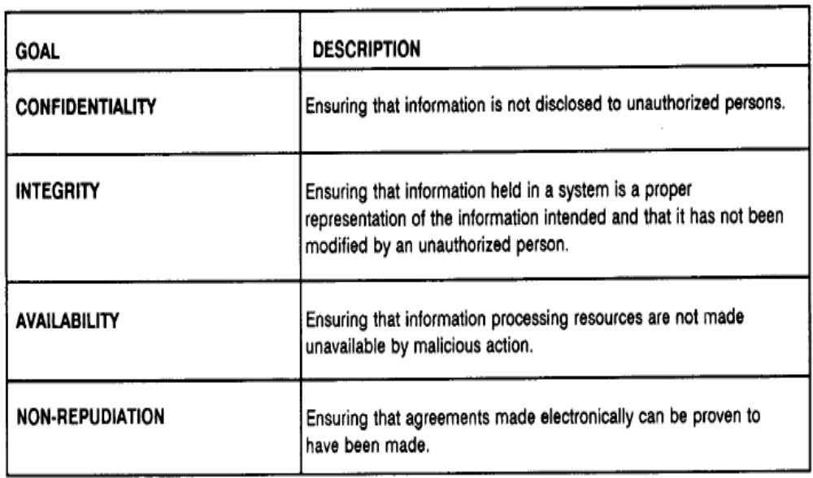
Common Security Requirements

Slide 7
SECURITY AND PRIVACY ISSUES
Concerns of security issues:
Availability :
It is to ensure its users can use them at any time, at any place.
Confidentiality :
It means keeping users’ data secret in the cloud systems.
Data integrity :
It means to preserve information integrity (i.e., not lost or modified by unauthorized users).

Slide 8
Control :
It means to regulate the use of the system, including the applications, its infrastructure and the data.
Audit :
It means to watch what happened in the cloud system, could be added virtualized application environment hosted on the virtual machine to provide facilities watching what happened in the system. ^{[3]}

Slide 9
THREATS TO CLOUD COMPUTING
Data Breaches :
In cloud computing, the virtual machines (VMs) are residing in the same physical host and when one VM is able to access information from another VM, data breach occurs.
Data Loss :
The things leading to permanent loss of data include malicious attacker, hard drive failure, fire or earthquake. Some of these reasons could be due to the service providers fault.
Account Hijacking :
Account hijacking uses attack methods such as fraud ,exploitation etc of software vulnerabilities where credentials and passwords are reused.

Slide 10
Denial-of-Service :
This attack attempts to make the system or network resources unavailable to the users from accessing their data and applications from cloud.
Abuse of Cloud Service :
The main concern is for the CSVs rather than cloud service clients since the users will be trying to hack the system to gain access to confidential data.
Malicious Insiders :
The employees who are working for cloud service providers such as the system administrator will have complete access to the confidential resources. Their access can be a big threat to customers to view confidential data. ^{[11]}

Slide 11
WHY DO WE NEED CLOUD-SECURITY ?
Cloud adoption is expected to accelerate in the coming years, organizations are still wary of the cloud as the right delivery environment for many business applications. The dominant concern is Security.
Businesses question whether their data is safe in the cloud, and how they can employ an on-demand service while maintaining regulatory and industry compliance.
Organizations are right to balk about going head first into the cloud without some guarantees about protection.

Slide 12
SECURITY MEASURES OF CLOUD
User control.
Investigative support, investigating inappropriate or illegal activity may be impossible in cloud computing.
Intrusion detection and prevention.

Slide 13
Misconfiguration takes place, because lack of expertise coupled with insufficient communication.
Threat to access important information is also a major concern which can lead to huge loss of data and can even lead to hacking.
Availability and backup. ^{[23]}

Slide 14
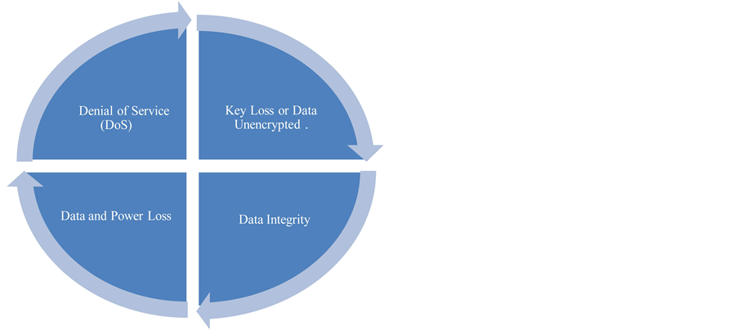
Four General Server Risks in Cloud

Slide 15
Denial of Service (DoS) :
Being of the latter is obviously always an issue for servers. The added risk to using the cloud is that attacks on other users of the cloud would affect your
portion.
Data Breaches:
Have greater potential of disaster on the cloud. A single flaw in a cloud service could cause one data breach to extend to a breach of the entire system.

Slide 16
Data loss :
It is an issue not unique to the cloud. Power loss is a potential scenario everywhere on Earth and sometimes unavoidable.
Data Integrity :
The risk of giving other access to your server’s internals and secrets is once again almost unavoidable . Unless you were to buy, setup, and implement your own server in your home you will probably have to trust someone else to help you, thereby risking the data’s integrity. ^{[4]}

Slide 17
APPLICATIONS OF CLOUD COMPUTING
Cloud computing provides dependable and secure data storage center.
Cloud computing can realize data sharing between different equipments.
The cloud provides nearly infinite possibility for users to use the internet.
Cloud computing does not need high quality equipment for the user and it is easy to use. ^{[3]}

Slide 18
FUTURE SCOPE OF CLOUD SECURITY
It is facing many challenges regarding the security of data.
Modification of this technology helps to secure the data.
Many research on this technology are taking place which would eventually help this technology to expand its scope in future leading to more secure data.
Architectures , thus it will help to grow the IT industry as well as advancement of this technology would help in big organizations as well as full-fill the requirement of public industry as well. ^{[23]}

Slide 19
STEPS TAKEN FOR BETTER CLOUD
There are organizations working towards a more secure cloud, such as the CSA (CLOUD SECURITY ALLIANCE).
Another is Silver Sky, an expert provider of cloud security and provider of “the industry’s only advanced Security-as-a-Service platform from the cloud”.
The CTO of Silver Sky, Andrew Jaquith, explains that many CIOs are moving their services to the cloud in order to save money, but that security remains a key concern and these moves may be insecure or at least hasty.
On the other hand, he also explains that many cloud service providers are becoming clearer, more transparent, and more assured than ever before that they could protect customer data.

Slide 20
SOLUTIONS OF ISSUES IN CLOUD SECURITY
Network and security audits
Security threat assessments
Secure network and infrastructure design
Network perimeter protection, including firewalls and intrusion detection
Remote access strategies, including VPN implementations
Data loss prevention for information in motion and at rest ^{[23]}

Slide 21
CONCLUSION
The Cloud provides many options for the everyday computer user as well as large and small businesses.
Clouds are more subjected to the data theft, malicious access, and unsecured internet access.
Efforts have been made to enforce confidentiality, integrity and privacy of data.
We have discussed the Issues, Factors Affecting the Data Security, Threats to it, Measures being taken towards it, Applications of it as well.

Slide 22
The customers before shifting their data enter to cloud, they should understand the sensitivity of data and choose the cloud model based on their requirement.
Thus it will help to grow the IT industry as well as advancement of this technology would help in big organizations as well as full-fill the requirement of public industry as well. ^{[23]}

Slide 23
Security at Different Levels
We need Security at following levels:
Server access security
Internet access security
Database access security
Data privacy security

Slide 24
Research Questions
At a Broad level,
Two major Questions are:
How much secure is the Data?
How much secure is the Code?

Slide 25
How much safe is data from Natural disaster?
Data can be redundantly store in multiple physical location.
Physical location should be distributed across world.

Slide 26

Data centre Security?
Professional Security staff utilizing video surveillance, state of the art intrusion detection systems, and other electronic means.
When an employee no longer has a business need to access datacenter his privileges to access datacenter should be immediately revoked.
All physical and electronic access to data centers by employees should be logged and audited routinely.
Audit tools so that users can easily determine how their data is stored, protected, used, and verify policy enforcement.

Slide 27
Backups of Data
Data store in database of provider should be redundantly store in multiple physical location.
Data that is generated during running of program on instances is all customer data and therefore provider should not perform backups.
Control of Administrator on Databases.

Slide 28
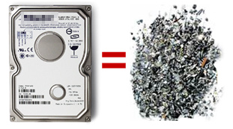
Data Sanitization
Sanitization is the process of removing sensitive information from a storage device.
What happens to data stored in a cloud computing environment once it has passed its user’s “use by date”
What data sanitization practices does the cloud computing service provider propose to implement for redundant and retiring data storage devices as and when these devices are retired or taken out of service.

Slide 29
Some virus and worm create--
Job Starvation Issue : where one job takes up a huge amount of resource resulting in a resource starvation for the other jobs.
Solutions:
Advanced reservations of resources
priority reduction

Slide 30
Information Security
Security related to the information exchanged between different hosts or between hosts and users.
This issues pertaining to secure communication, authentication, and issues concerning single sign on and delegation.
Secure communication issues include those security concerns that arise during the communication between two entities.
These include confidentiality and integrity issues. Confidentiality indicates that all data sent by users should be accessible to only “legitimate” receivers, and integrity indicates that all data received should only be sent/modified by “legitimate” senders.
Solution: public key encryption, X.509 certificates, and the Secure Sockets Layer (SSL) enables secure authentication and communication over computer networks.

Slide 31
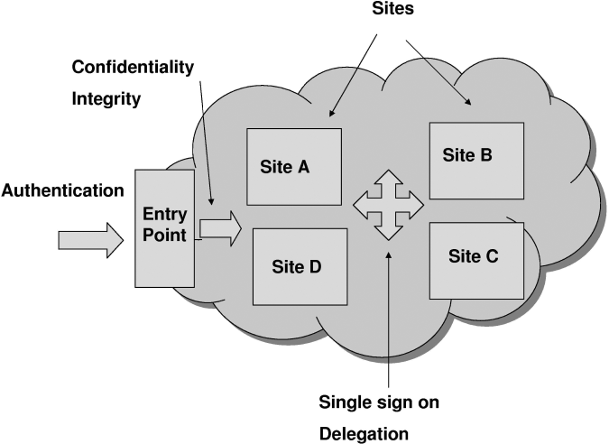

Slide 32
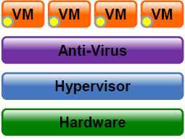
We need Anti –Virus layer to help control
and protect:
- Memory and CPU
- Networking
- Process execution control
- Storage

Slide 33
Management Related Issues:
Management is important as the cloud is heterogeneous in nature and may consist of multiple entities, components, users, domains, policies, and stake holders.
Credential Management:Credential management systems store and manage the credentials for a variety of systems and users can access them according to their needs.
Secure and safe storage of credentials is equally important.

Slide 34
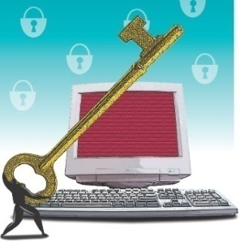
How secure is encryption Scheme
Is it possible for all of my data to be fully encrypted?
What algorithms are used?
Who holds, maintains and issues the keys?
Problem:
Encryption accidents can make data totally unusable.
Encryption can complicate availability
Solution
The cloud provider should provide evidence that encryption schemes were designed and tested by experienced specialists.

Slide 35
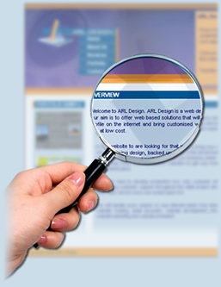
Investigative Support
Investigating inappropriate or illegal activity may be difficult in cloud computing because
-- logging and data for multiple customers may be co-located
-- may also be geographically spread across an ever-changing set of hosts and data centers.
Solution: get a contractual commitment to support specific forms of investigation, along with evidence that the vendor has already successfully supported such activities.

Slide 36
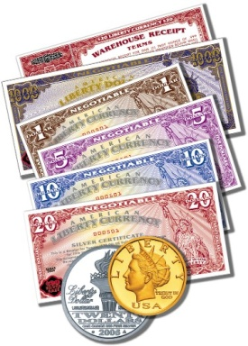
How to ensure Users that both
Data and Code are safe?
Very hard for the customer to actually verify the currently implemented security practices and initiatives of a cloud computing service provider because the customer generally has no access to the provider’s facility which can be comprised of multiple facilities spread around the globe.
Solution:
Provider should get some standard certificate from some governing or standardized institution that ensure users that provider has established adequate internal control and these control are operating efficiently.

Slide 37
Trends associated with Cloud Security
Increasing Partnerships between CSPs and Security Solution Providers Expected
Increasing Emergence of Cloud Service-specific Security Solution Providers
Identity Management and Encryption to Remain the Top Cloud Security Solutions Offered
Increasing Availability of Cloud Security Solutions for Small and Medium-sized Businesses (SMBs)
Emergence of Strong Cloud Security Standard and Guidelines

Slide 38
Why is Cloud Security Important
Increasing Usage of Cloud Services in Non-traditional Sectors
Growing Adoption of Cloud Services in Government Departments
Rise in Cloud Service-specific Attacks
Growing Usage of Cloud Services for Critical Data Storage
Rise in Employee Mobility

Slide 39
What are the challenges?
CSPs believe that Security is End-users’ Issue
Lack of Awareness about Cloud Security
Inconsistent Network Connection Issues
Lack of Proper Cloud Security Standards

Slide 40
What End-users/customers expect from Cloud Security
Strong Overall Security Offered
Suite of Security Solutions Offered
Encryption Key Management Features Offered
Availability of Fine Granular Control

